Slide 1
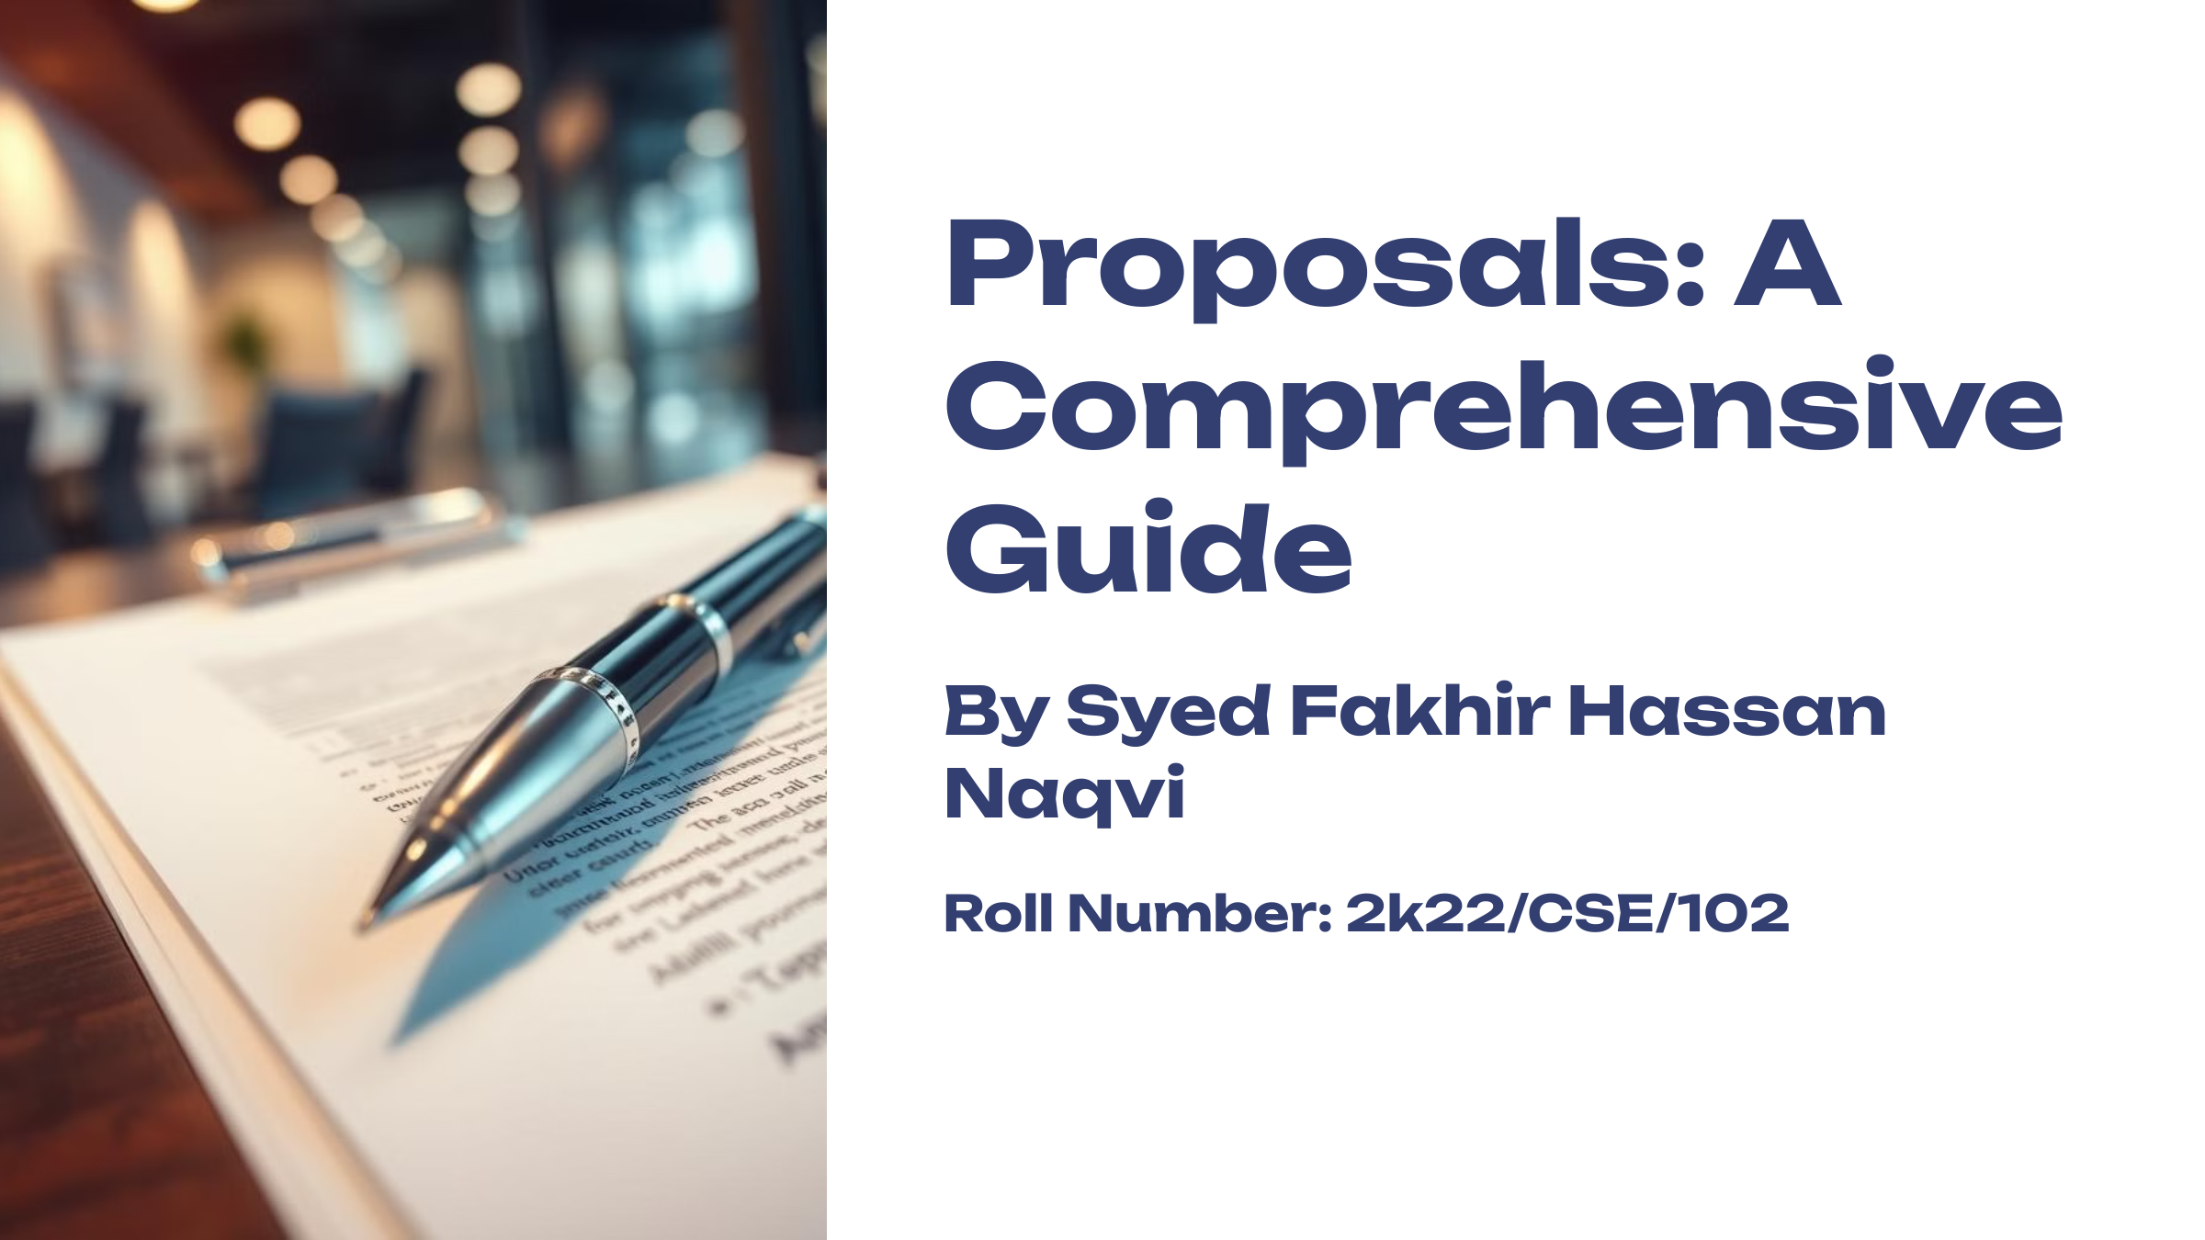

Slide 2

What is a Proposal?
A proposal is a structured document that presents ideas and solutions. It serves as a roadmap for decision-makers. Professional proposals combine clear writing with compelling evidence.

Slide 3




Purpose of Proposals
Approval
Secure authorization for projects and initiatives through detailed planning and justification.
Problem-Solving
Address specific challenges with innovative and well-researched solutions.
Funding
Request financial support by demonstrating value and return on investment.

Slide 4
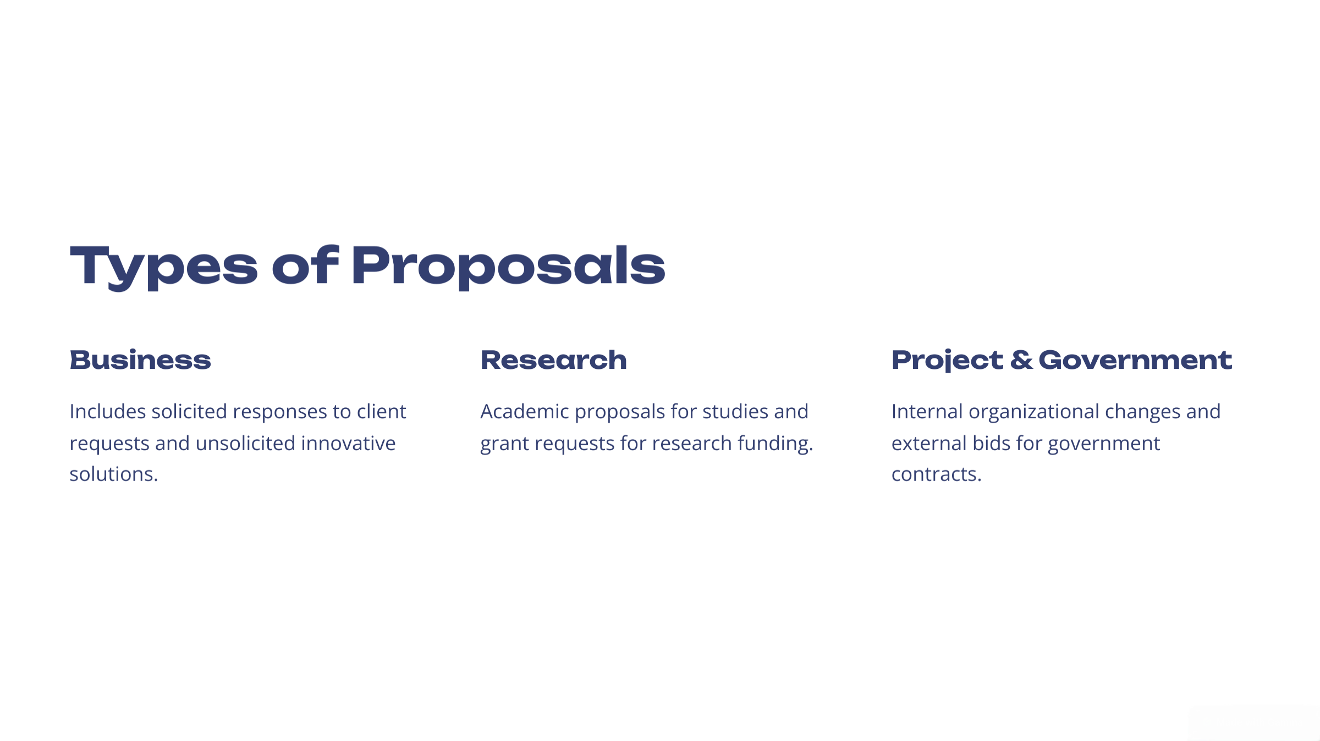

Slide 5

Proposal Components
1
Opening Elements
Title page introduces while executive summary captures key points efficiently.
2
Core Content
Problem statement, objectives, and methodology form the proposal's backbone.
3
Supporting Details
Budget, timeline, and evaluation plan provide concrete implementation framework.

Slide 6
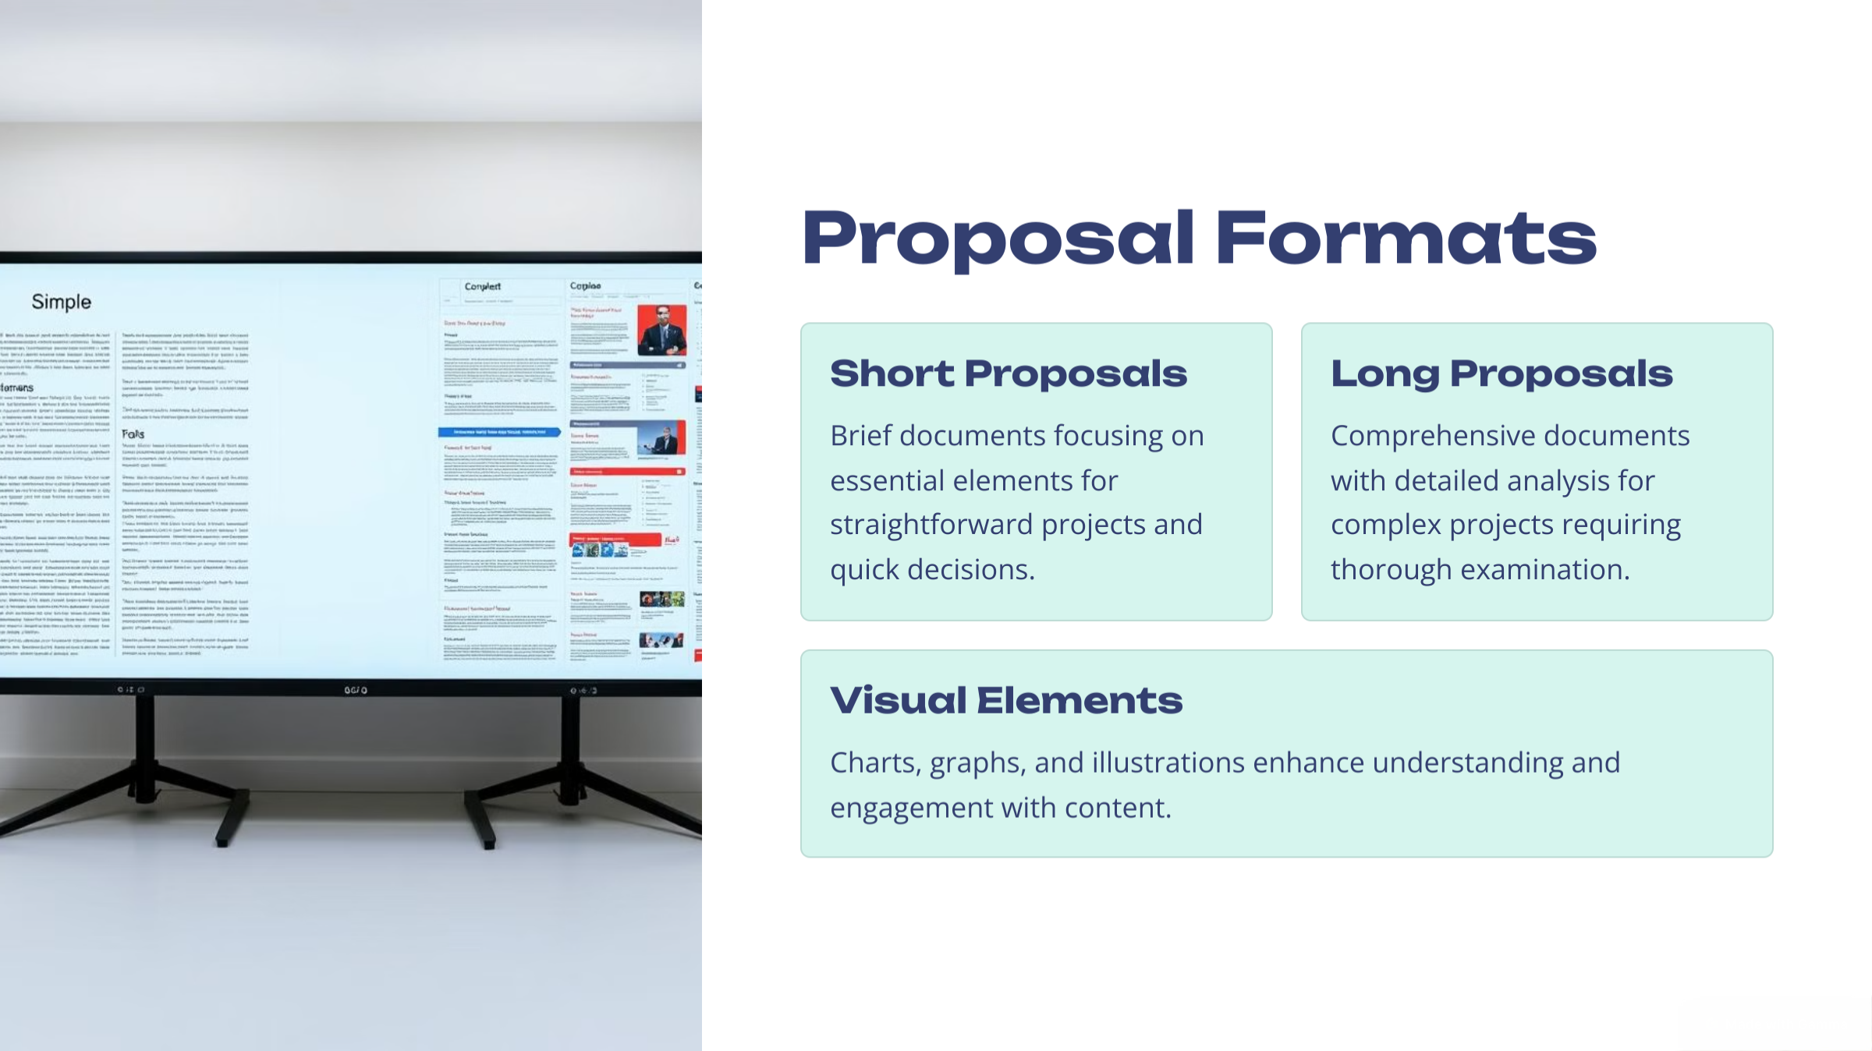

Slide 7
